Slide 1





4TW
CALISTA
ANGEL
Engineering
JESS
LYSSAH

Slide 2






4TW
Analytics
YAN
LILI
KAT
CHAR
KAR

Slide 3


UNEVEN PROGRESS:
IDENTIFYING LAGGING REGIONS IN 4PS AND CRAFTING TARGETED SOLUTIONS

Slide 4

4Ps
PANTAWID PAMILYANG PILIPINO PROGRAM
Break the cycle of intergenerational poverty
Conditional cash grants to households for health and education
Targets the poorest households identified through Listahanan
Source: Republic Act No. 11310 – Pantawid Pamilyang Pilipino Program Act (2019), Lawphil Project
4

Slide 5
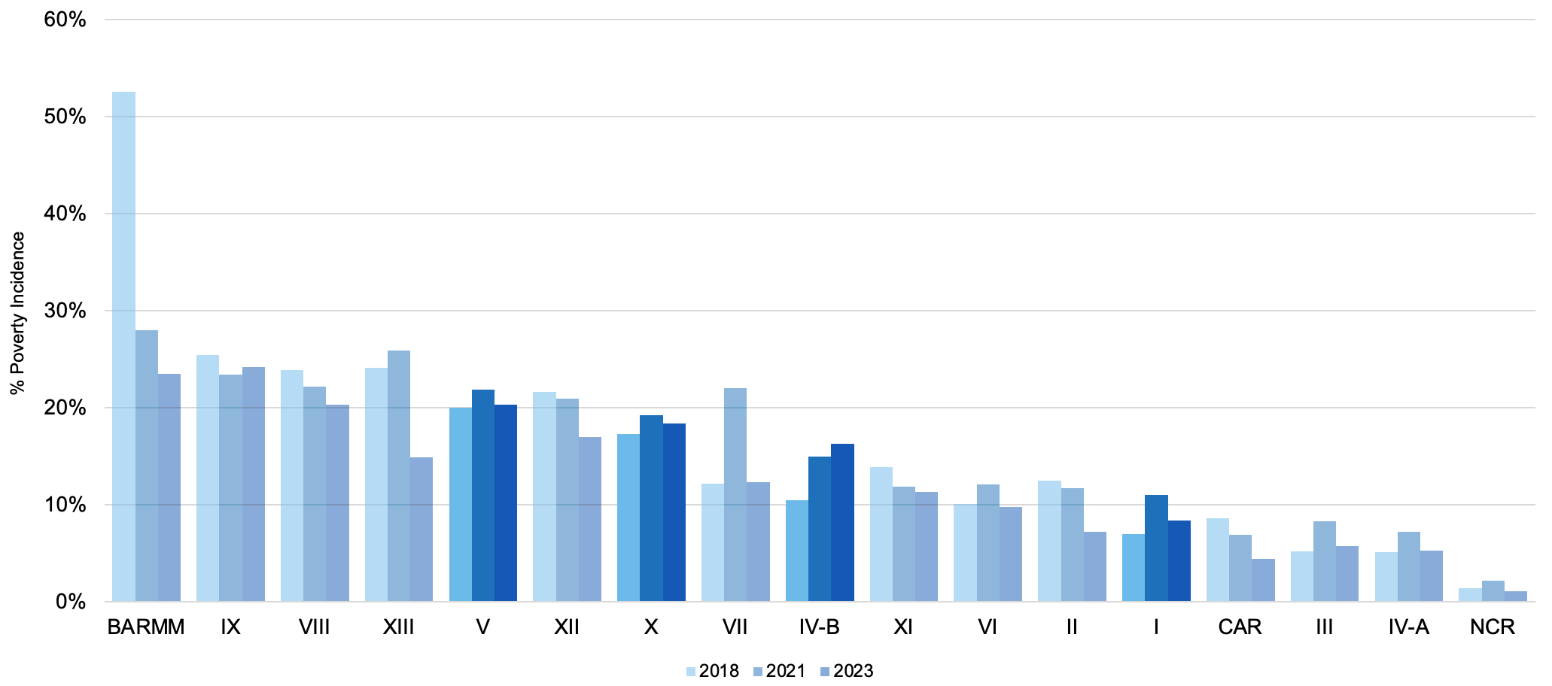
Still, 4Ps is not enough...
Local factors may prevent the program from fully achieving its goals in some regions.
Source: PSA Poverty Incidence by Region (2018, 2021, and 2023)
5

Slide 6




WHAT DOES 4PS AIM TO ACHIEVE?
1
3
Health and
Nutrition
Child Labor
2
4
Community Participation
Education
6

Slide 7

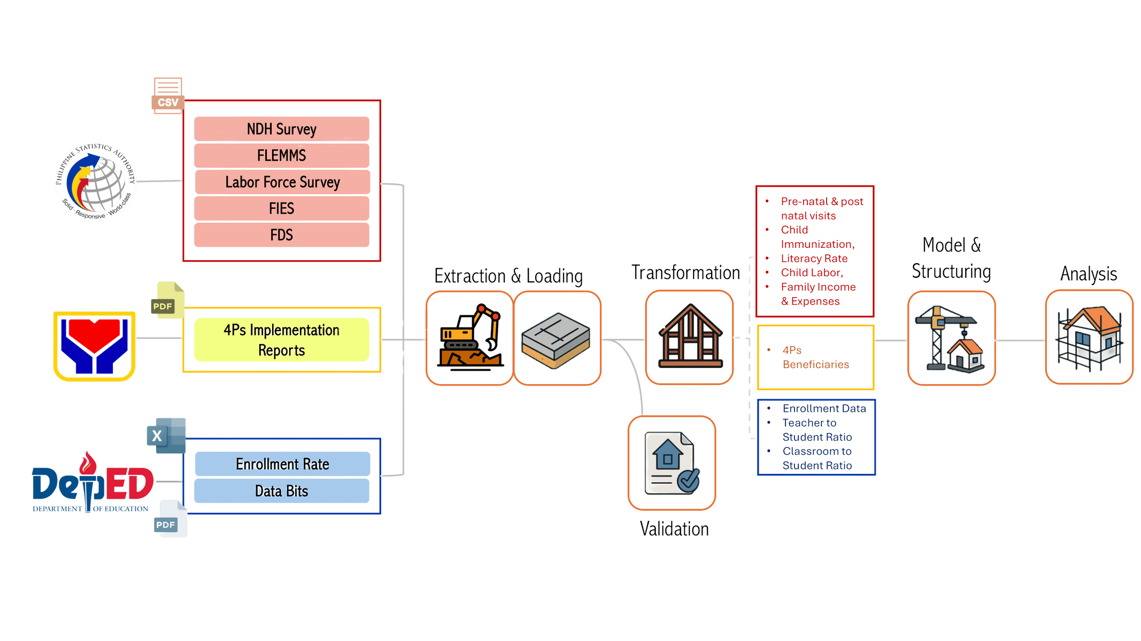
THE DATA BLUEPRINT
For the detailed view, please visit: https://github.com/luciten/ftw-de-capstone-project/blob/main/Draft_Data%20Pipeline.md
7

Slide 8

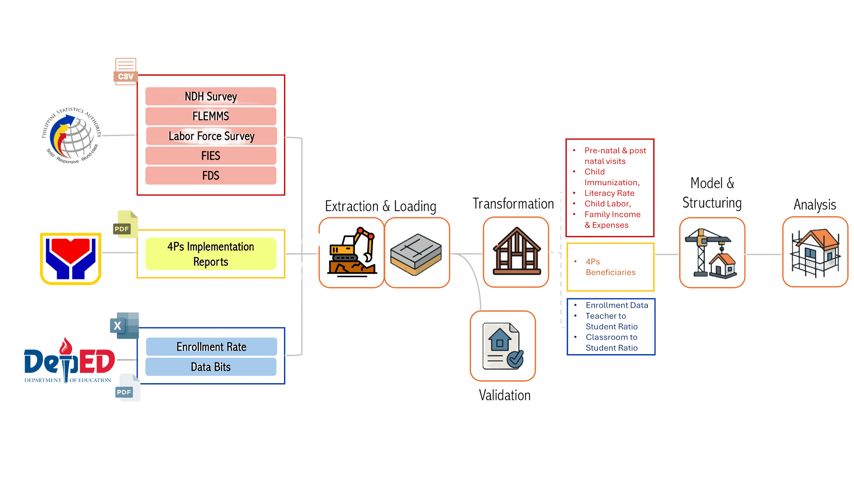
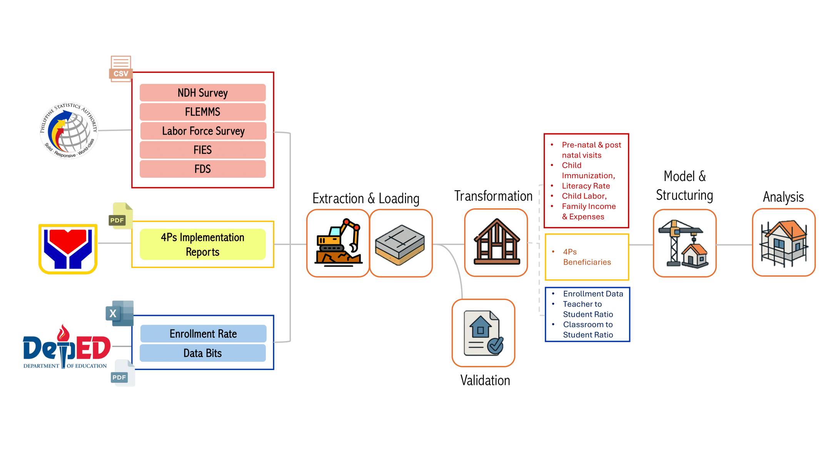
GATHERING THE MATERIALS
Collected “raw materials” from PSA, DSWD, and DepEd — health, education, and welfare data
Different formats (CSV, Excel, PDF) unified for one goal: better visibility of local poverty drivers
Sets the stage for building a data system that supports smarter, fairer decisions
For the detailed view, please visit: https://github.com/luciten/ftw-de-capstone-project/blob/main/Draft_Data%20Pipeline.md
8

Slide 9
LAYING THE FOUNDATION
Automated collection from multiple agencies to reduce manual work
Loaded raw files into one structured base for processing
Built a solid, consistent foundation for data integration
Improved efficiency and streamlined our update process
For the detailed view, please visit: https://github.com/luciten/ftw-de-capstone-project/blob/main/Draft_Data%20Pipeline.md
9

Slide 10

SHAPING & STRENGTHENING
From raw files, necessary datapoints are extracted
Standardized column names, region codes, and formats across surveys
Validated accuracy and consistency to ensure error-free datasets
Result:
Reliable and transparent data ready for meaningful analysis
For the detailed view, please visit: https://github.com/luciten/ftw-de-capstone-project/blob/main/Draft_Data%20Pipeline.md
10

Slide 11
FINISHING THE BUILD
Transformed data into structured, ready-to-use tables
Connected datasets by region and year across health, education, labor, etc.
Made data actionable, accessible, and ready to guide decisions
For the detailed view, please visit: https://github.com/luciten/ftw-de-capstone-project/blob/main/Draft_Data%20Pipeline.md
11

Slide 12
Health and
Nutrition
Child Labor
Community Participation
Education
12

Slide 13
Performance Metric
Performance
4Ps Members
Performance
4Ps Members
Q2
Q1
Performance
4Ps Members
Performance
4Ps Members
4Ps Beneficiaries
Q3
Q4
Critical Focus Areas
13

Slide 14
Health and
Nutrition
Child Labor
Community Participation
Education
14

Slide 15
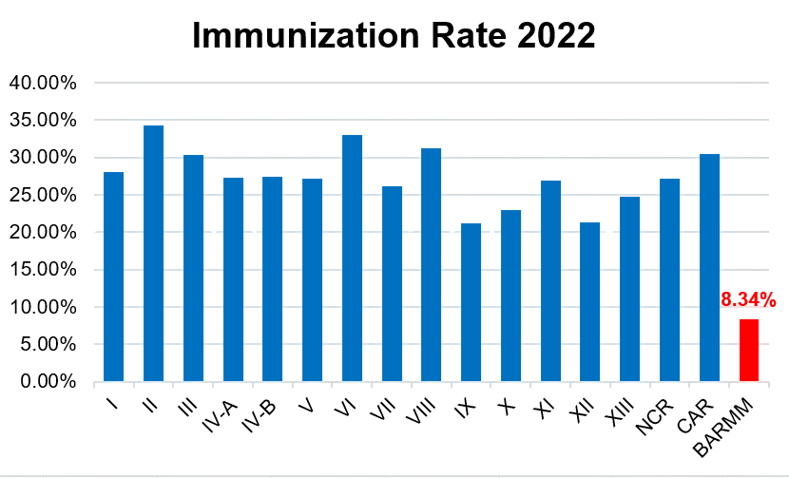
According to
WHO-UNICEF national routine vaccine coverage in 2022 was about 66%.
Immunization rate of 4Ps children remains below 35%.
Source: https://data.unicef.org/topic/child-health/immunization & https://immunizationdata.who.int/listing.html
15

Slide 16
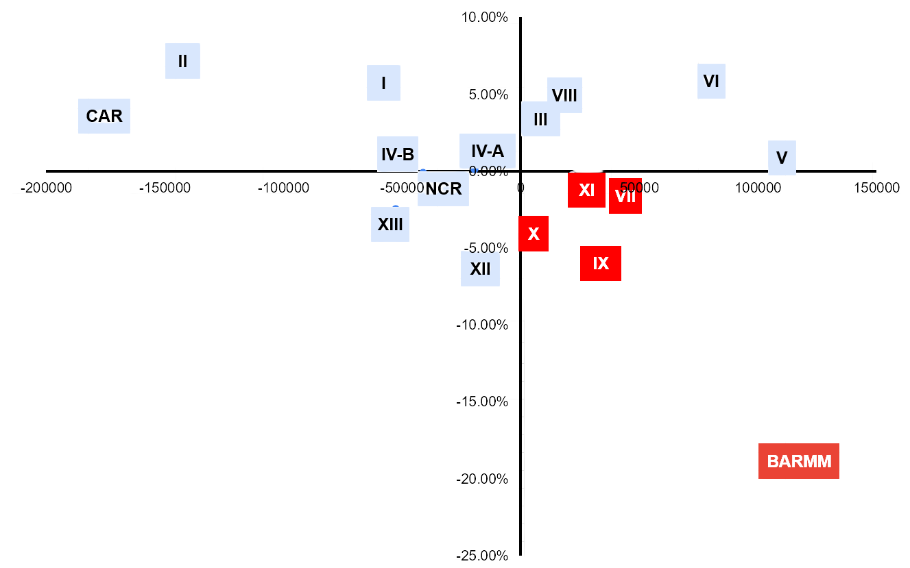
Immunization Rate 2022
4Ps Beneficiaries
Critical Focus Areas
Median value used to determine whether the rate is relatively high or low. Plotted as X [x - median (x)], Y [y - median (y)]
16

Slide 17
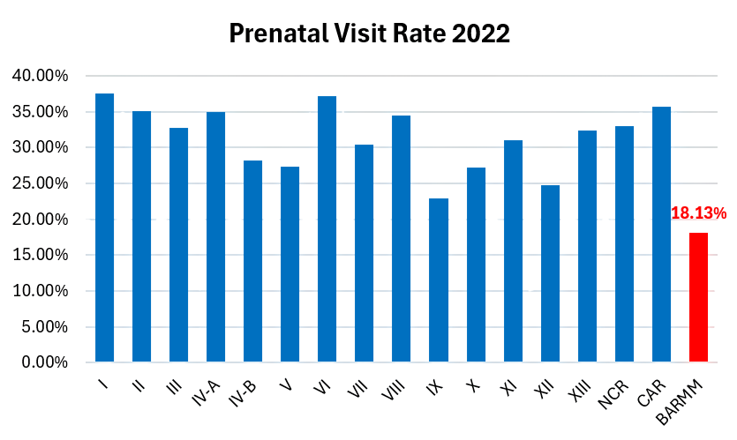
NDHS 2022 reports that 83% of Filipino women received at least four ANC visits.
32.42% of pregnant 4Ps members attended prenatal visits.
Source: https://dhsprogram.com/pubs/pdf/FR381/FR381.pdf?utm_source
17

Slide 18
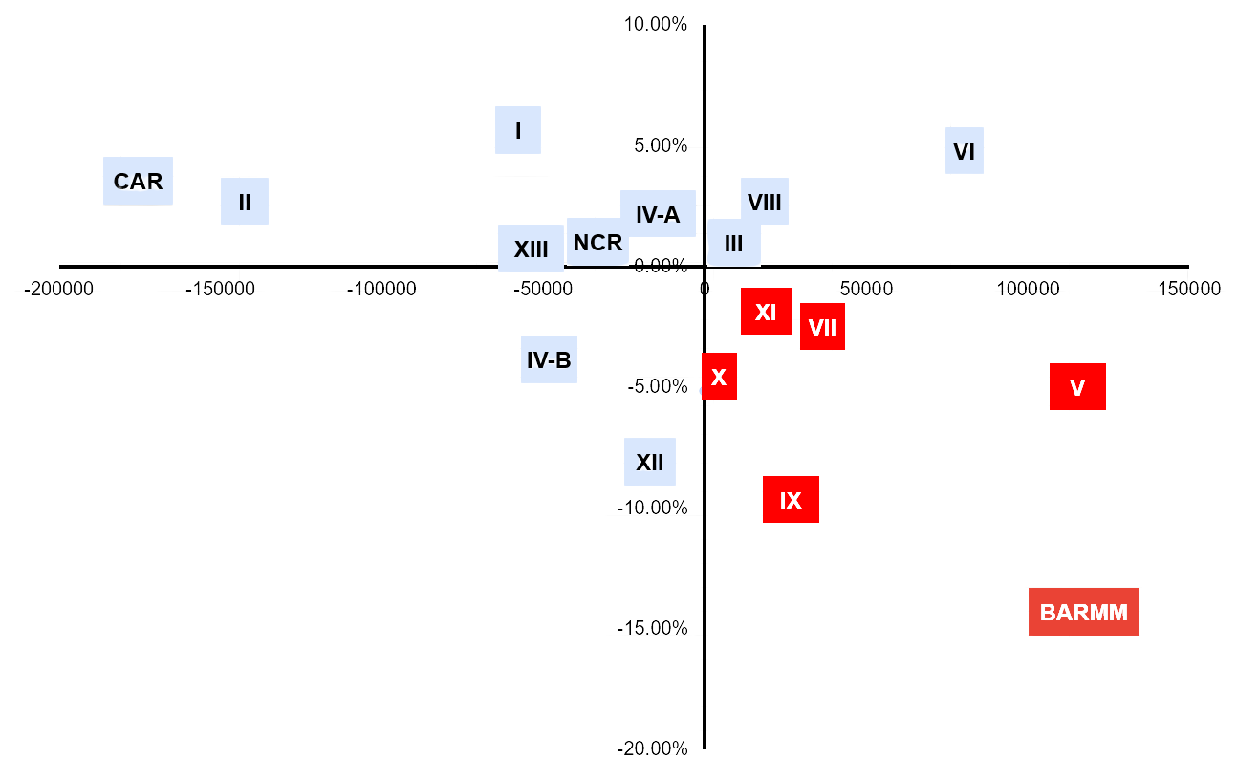
Prenatal Visit Rate 2022
4Ps Beneficiaries
Critical Focus Areas
Median value used to determine whether the rate is relatively high or low. Plotted as X [x - median (x)], Y [y - median (y)]
18

Slide 19
Health and
Nutrition
Child Labor
Community Participation
Education
19

Slide 20
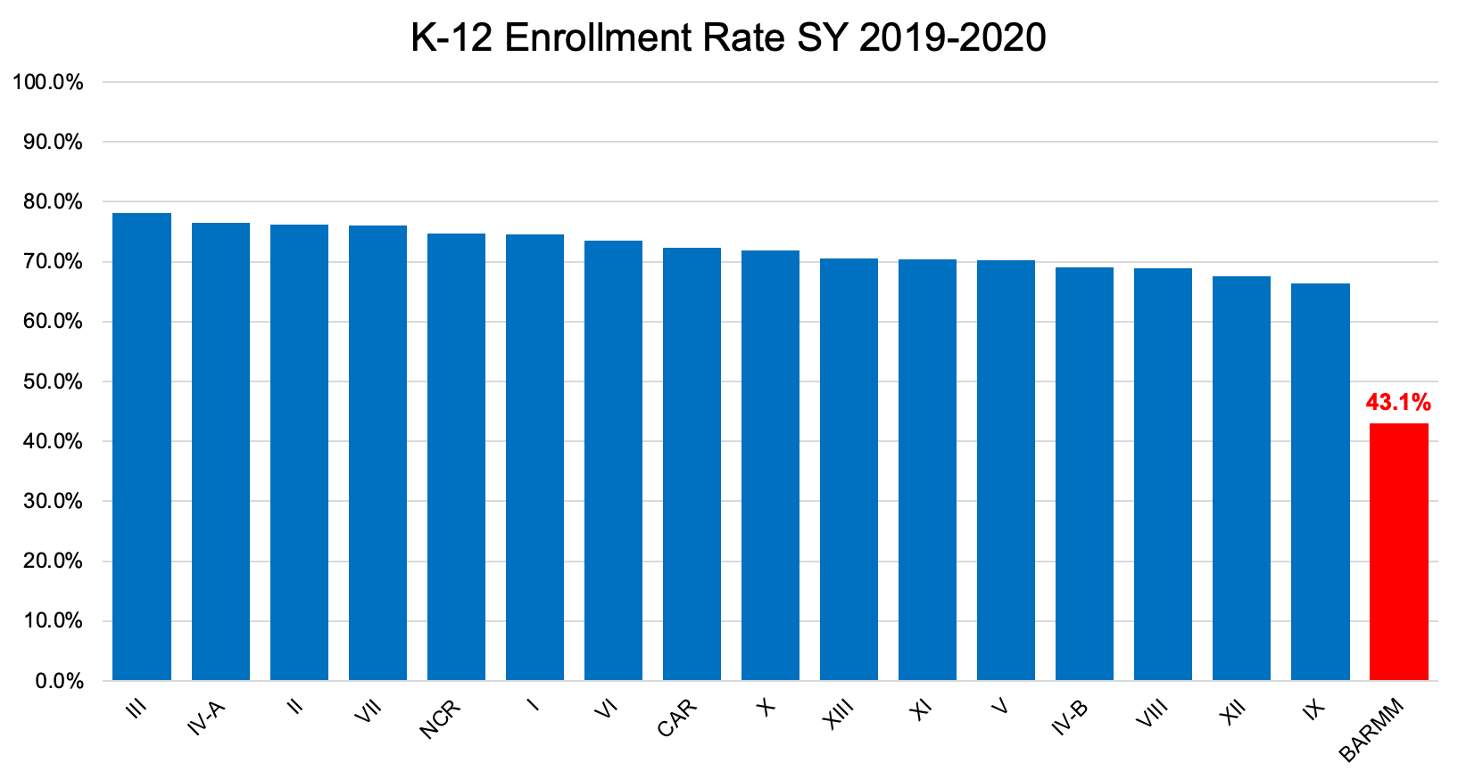
BARMM’s enrollment rate falls behind all other regions
Source: DepEd Basic Education Development Plan - Average Enrollment Rate per Region (SY 2019–2020)
20

Slide 21
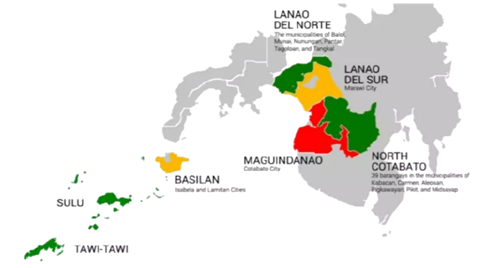
BARMM continues to face low school participation due to:
inaccessible schools
classroom shortages
conflict-affected areas
limited access to libraries and internet connectivity
Source: The Philippines Human Capital Review 2024 Annex 10 - LGU Case Study: Cotabato City, Bangsamoro Autonomous Region in Muslim Mindanao
21

Slide 22
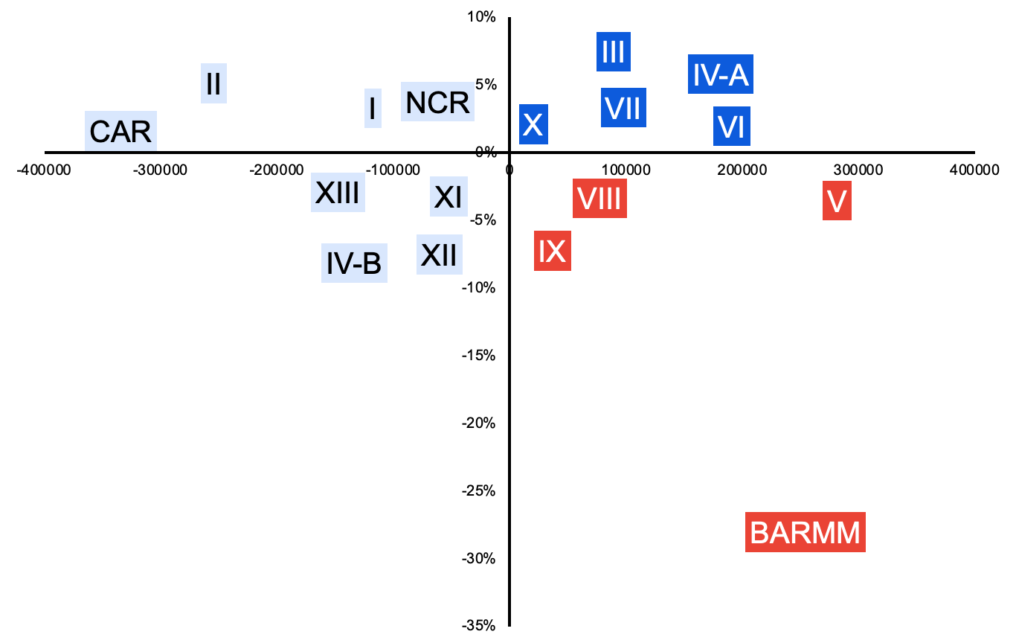
Enrollment Rate
4Ps Beneficiaries
Critical Focus Areas
Median value used to determine whether the rate is relatively high or low. Plotted as X [x - median (x)], Y [y - median (y)]
22

Slide 23
Health and
Nutrition
Child Labor
Community Participation
Education
23

Slide 24
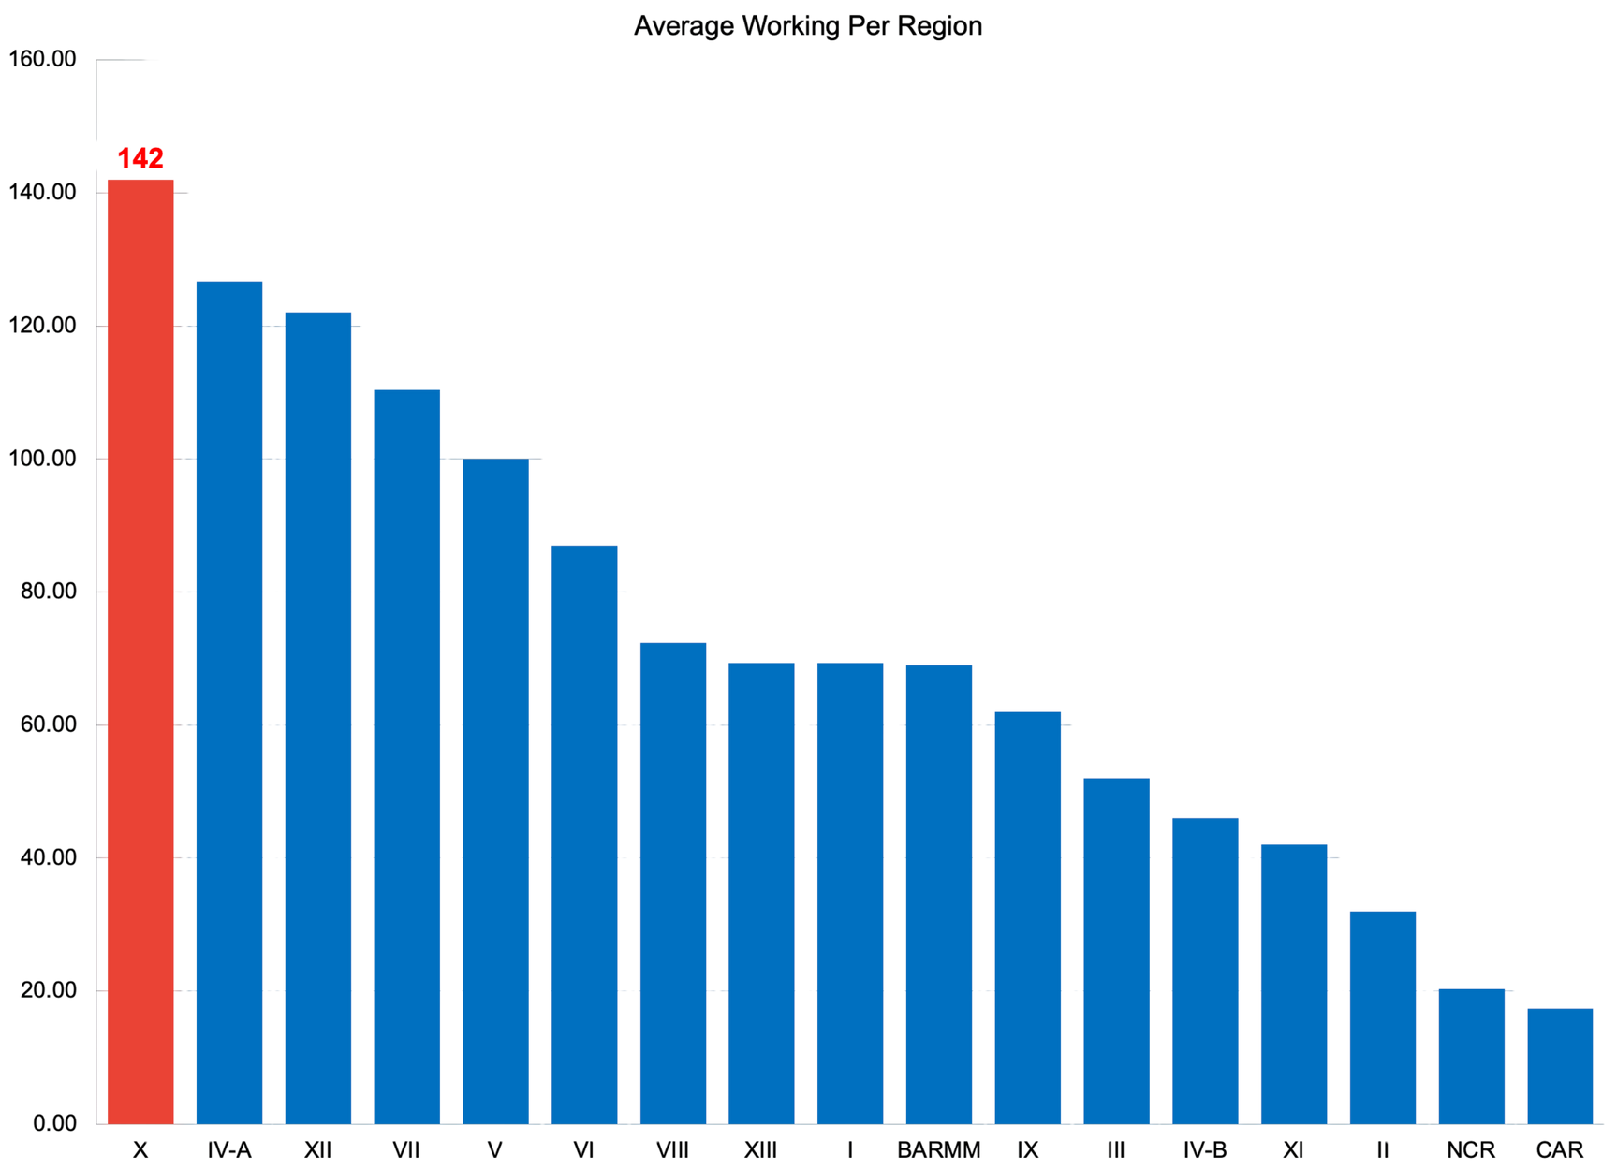
Region X records the highest average number of working children at 142 out of 1,504.
Source: https://psa.gov.ph/content/working-children-situation (Year: 2020 to 2022)
24

Slide 25
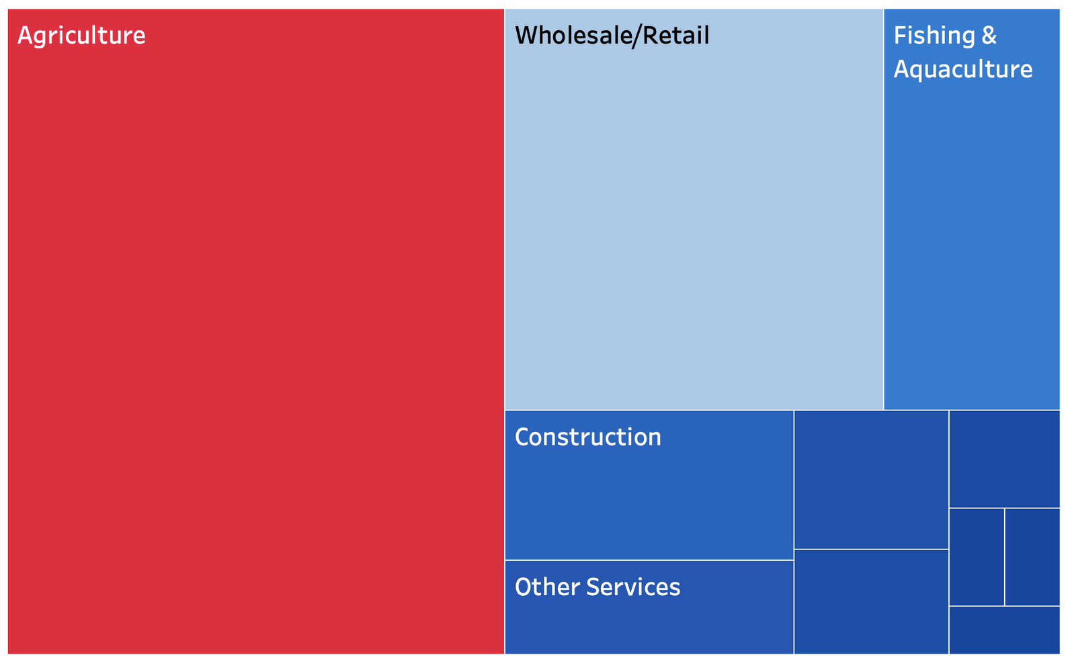
Children aged 5–17 are already working in Region X, mostly in Agriculture. This reflects national data showing farming as the top job done by children across all regions.
Source: https://psa.gov.ph/content/working-children-situation (Year: 2020 to 2022)
25

Slide 26
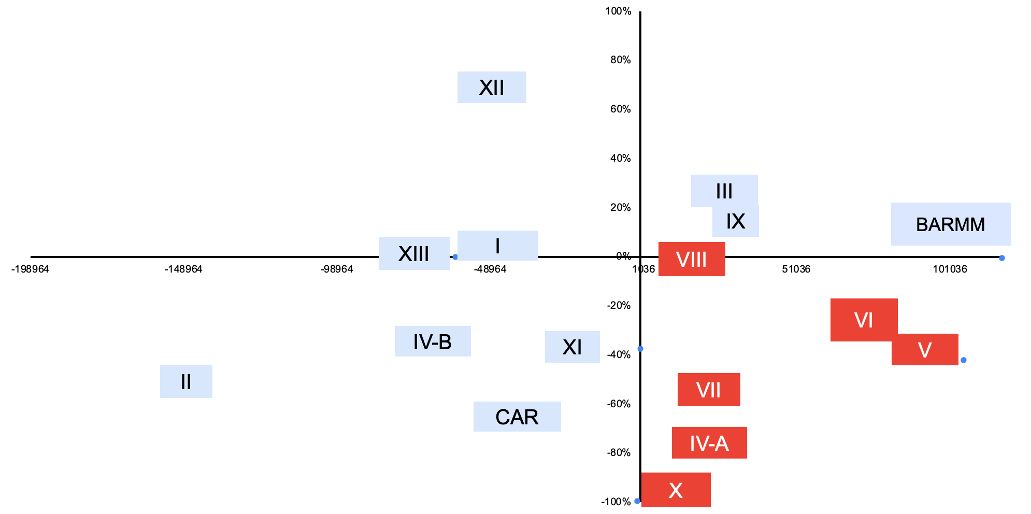
Working Children
4Ps Beneficiaries
Critical Focus Areas
Median value used to determine whether the rate is relatively high or low. Plotted as X [x - median (x)], Y [y - median (y)]
26

Slide 27
Health and
Nutrition
Child Labor
Community Participation
Education
27

Slide 28
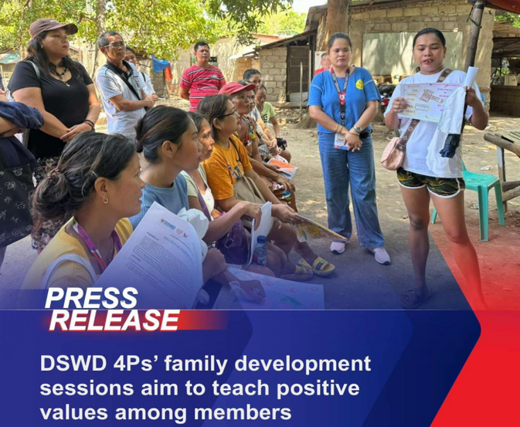





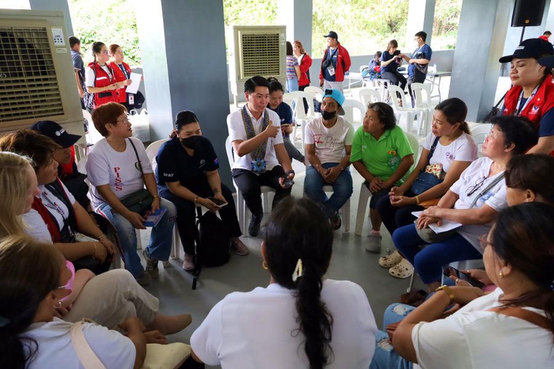
FAMILY DEVELOPMENT SESSION
Source: https://pantawid.dswd.gov.ph/wp-content/uploads/2018/08/FDS
28

Slide 29
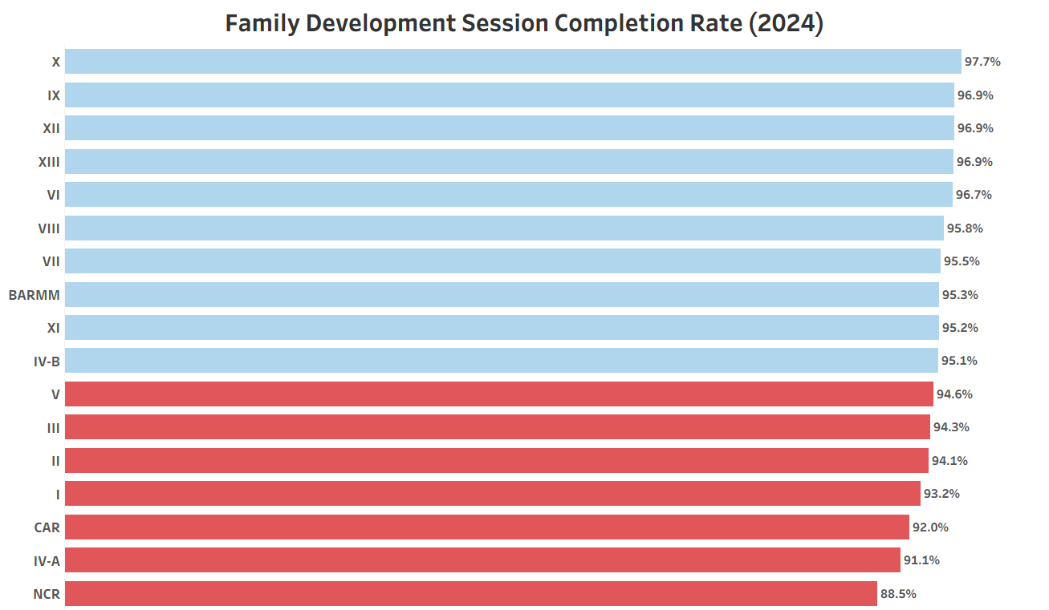
National FDS Compliance Near 95% Target
—but 7 Regions Lag Behind
29

Slide 30
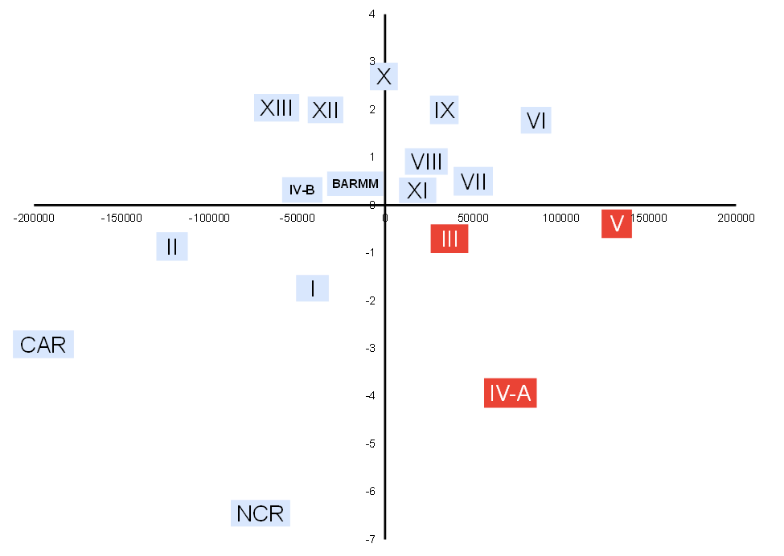
Regions III, IV-A, and V below 95% FDS Compliance Despite Large 4Ps Coverage
FDS Compliance
4Ps Beneficiaries
Critical Focus Areas
Target FDS Compliance: 95%
Average 4Ps beneficiaries: 236,495
Median value used to determine whether the rate is relatively high or low. Plotted as X [x - median (x)], Y [y - median (y)]
30

Slide 31

Identifying Our Focus
Multiple Metrics to a Single Strategy
31

Slide 32
Performance Metric
Performance
4Ps Members
Performance
4Ps Members
Q2
Q1
Performance
4Ps Members
Performance
4Ps Members
4Ps Beneficiaries
Q3
Q4
Critical Focus Areas
32

Slide 33
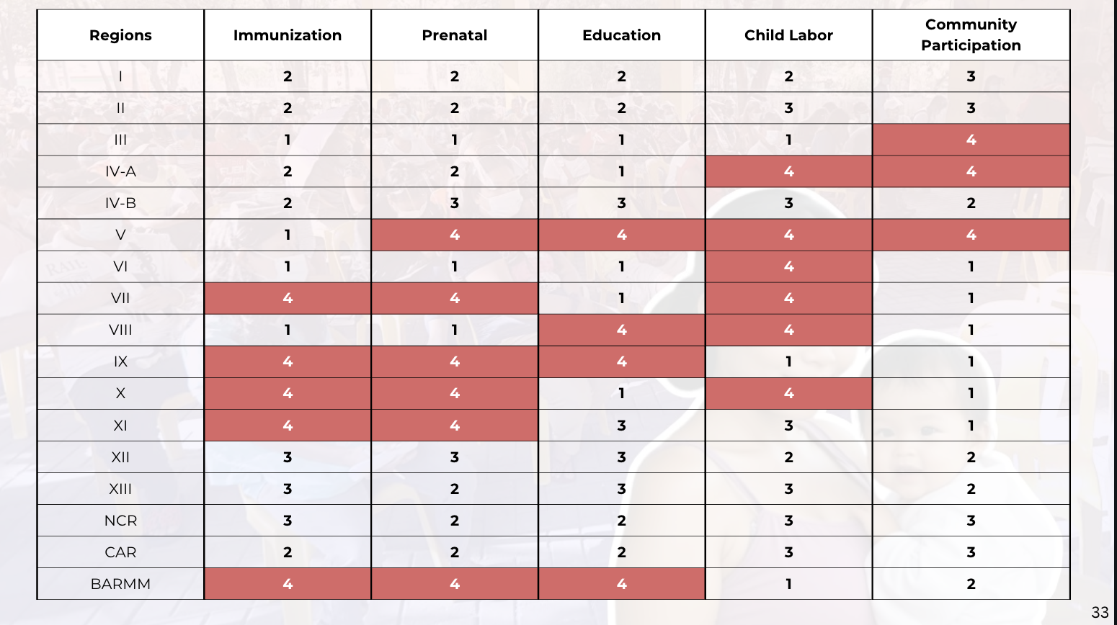
33

Slide 34
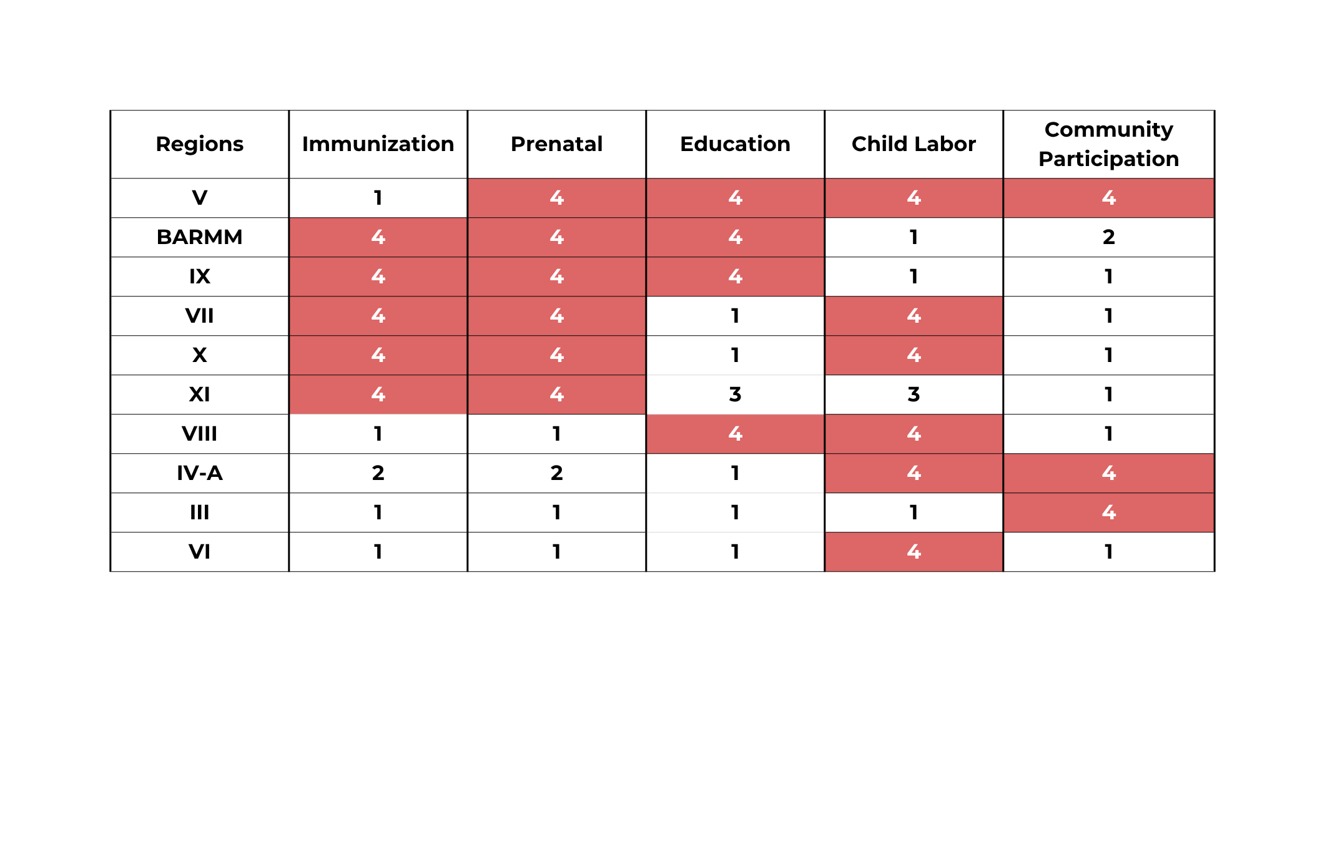
34

Slide 35
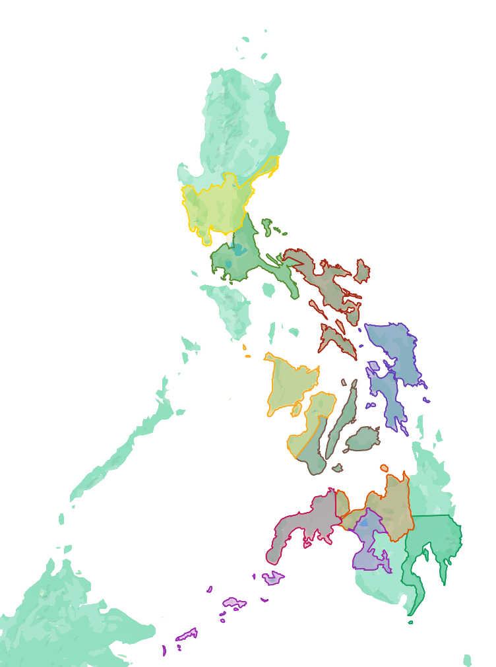
III
IV-A
WHAT NOW?
V
VIII
VI
VII
X
IX
XI
BARMM
35

Slide 36
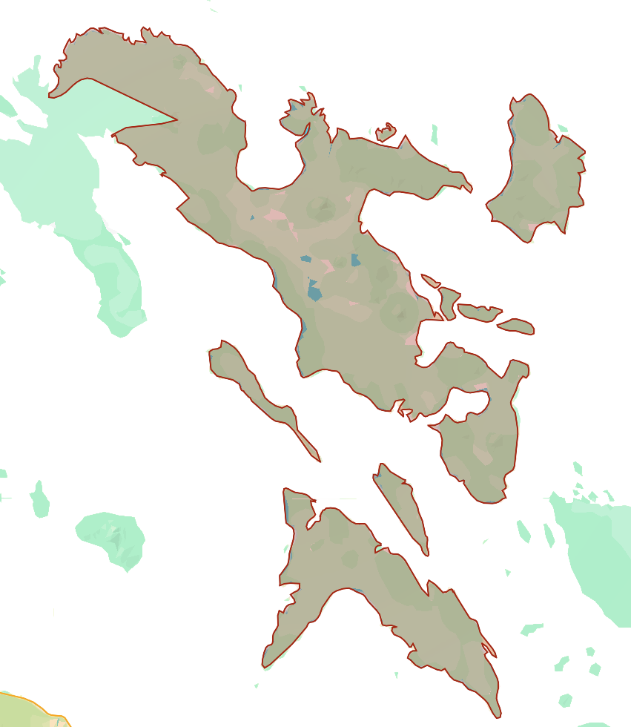
V - Bicol Region
Underlying Issues:
Disaster instability, island isolation
Recommendations:
Portable Health & Learning Pods
Island Reach Boat Clinics & Learning Boats
Post-Disaster Child Safety Network
Health and
Nutrition
Child Labor
Education
Community Participation
36

Slide 37
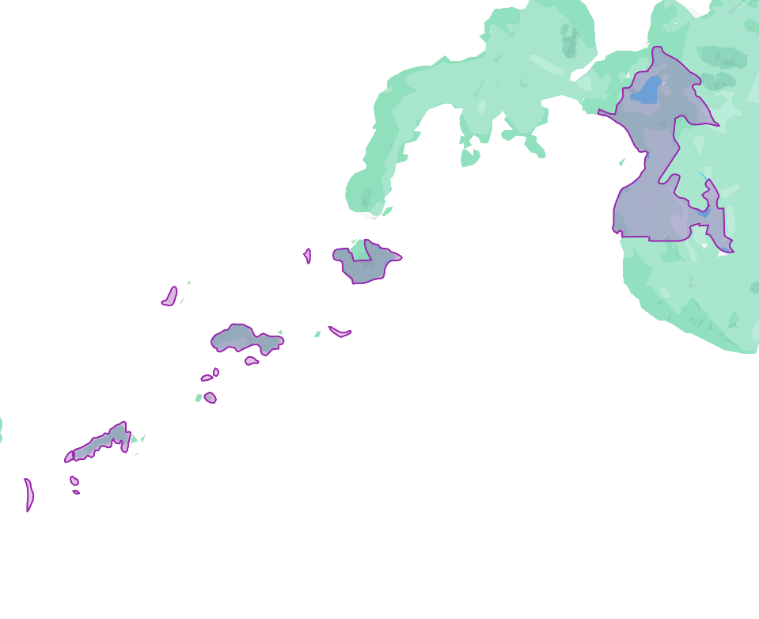
BARMM
Underlying Issues:
Conflict, displacement, cultural hesitancy
Recommendation:
Faith-based health dialogues and mobile education caravans.
Health and
Nutrition
Child Labor
Education
Community Participation
37

Slide 38
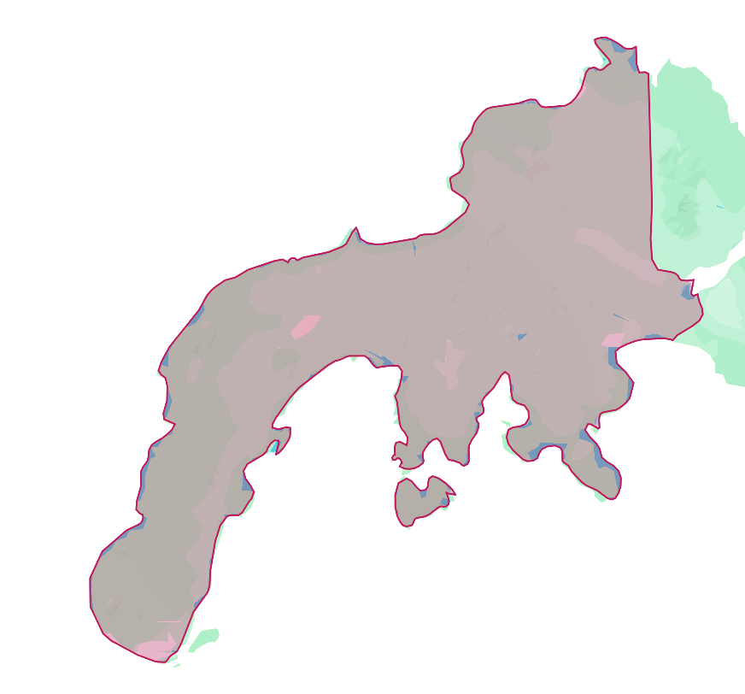
IX – Zamboanga Peninsula
Underlying Issues:
Isolation, cultural barriers, conflict zones
Recommendation: Services co-developed with peace networks and cultural mediators.
Health and
Nutrition
Child Labor
Education
Community Participation
38

Slide 39
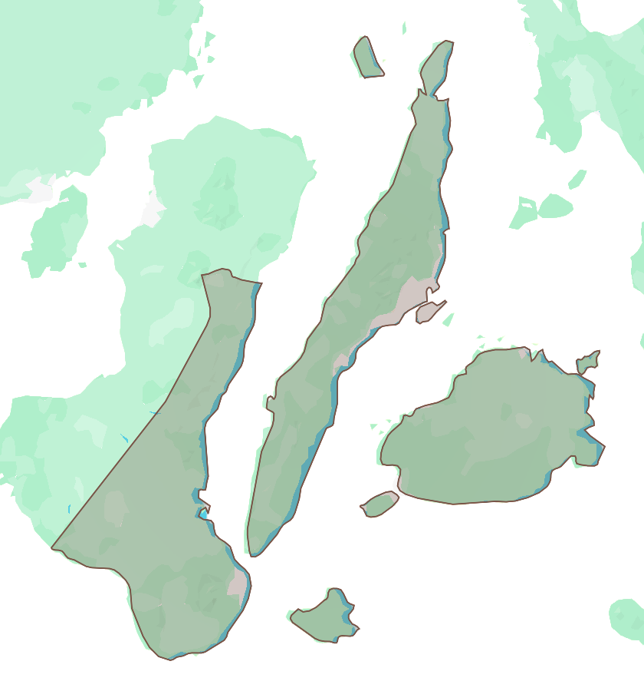
VII - Central Visayas
Underlying Issues:
Vaccine hesitancy, health manpower gaps
Recommendations:
Barangay Health-On-Wheels
Community Health Aide Expansion & Child Safety Monitoring
Health and
Nutrition
Child Labor
Education
Community Participation
39

Slide 40
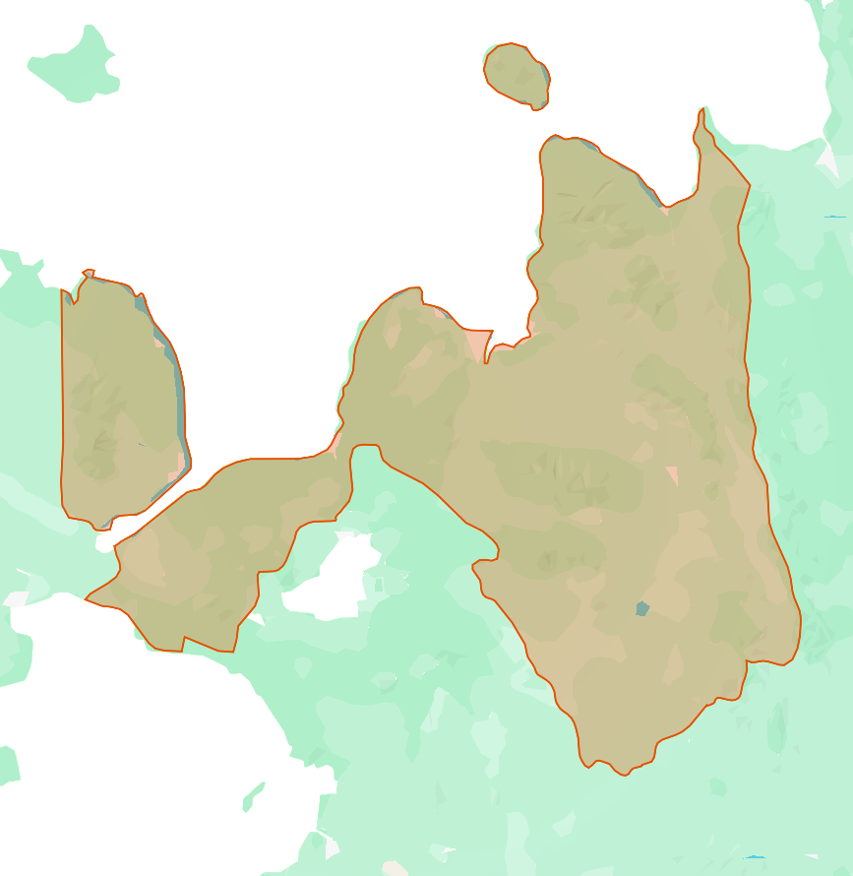
X – Northern Mindanao
Underlying Issues:
Farm work, dispersed communities, health worker shortage
Recommendation:
Farm-based learning centers with rotating para-health workers.
Health and
Nutrition
Child Labor
Education
Community Participation
40

Slide 41
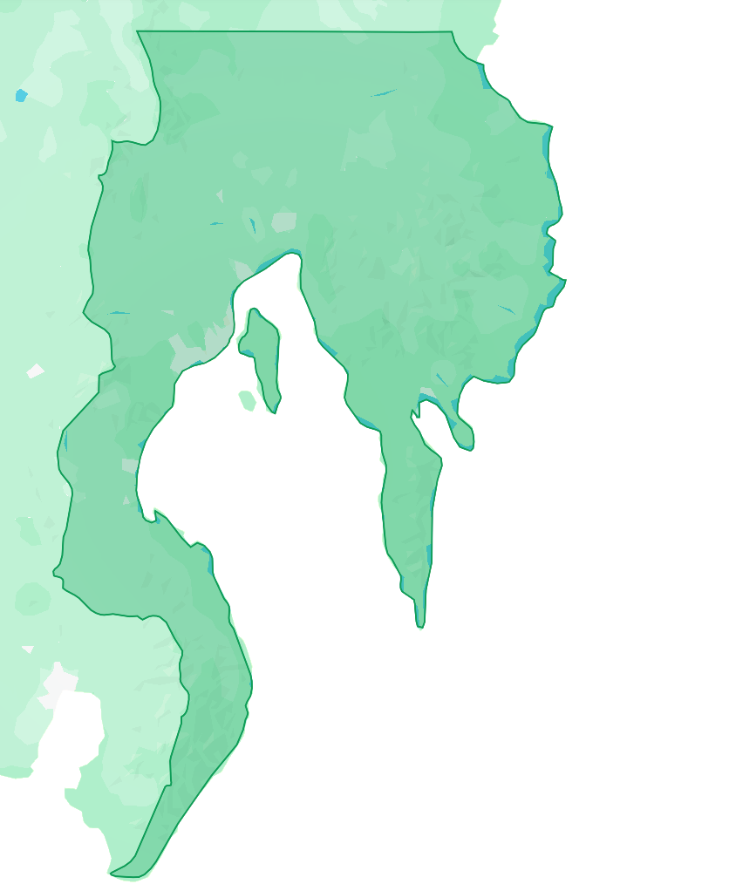
XI – Davao Region
Underlying Issues:
Poverty-driven labor, few health workers
Recommendation:
Scholarships for local youth to serve as health workers.
Health and
Nutrition
Child Labor
Education
Community Participation
41

Slide 42
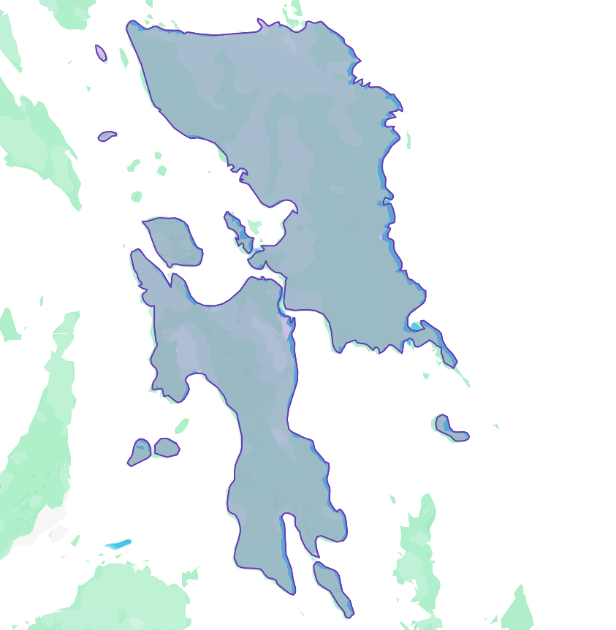
VIII – Eastern Visayas
Underlying Issues:
Disaster recovery burden, poverty-driven child labor
Recommendation:
School re-entry incentives and child protection in recovery plans.
Health and
Nutrition
Child Labor
Education
Community Participation
42

Slide 43
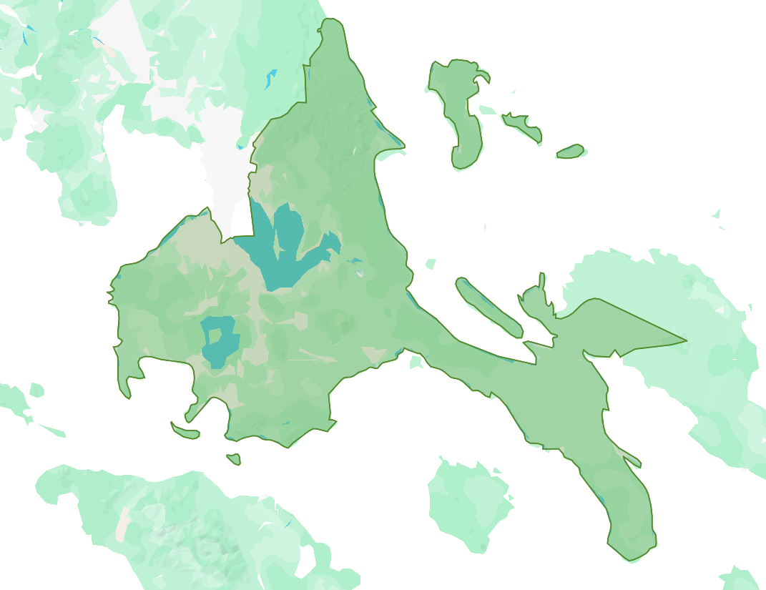
IV-A - CALABARZON
Underlying Issues:
Urban time poverty, industrial zone pressure
Recommendation:
Youth Workshield Monitoring
Shift-Safe Leave Program
Health and
Nutrition
Child Labor
Education
Community Participation
43

Slide 44
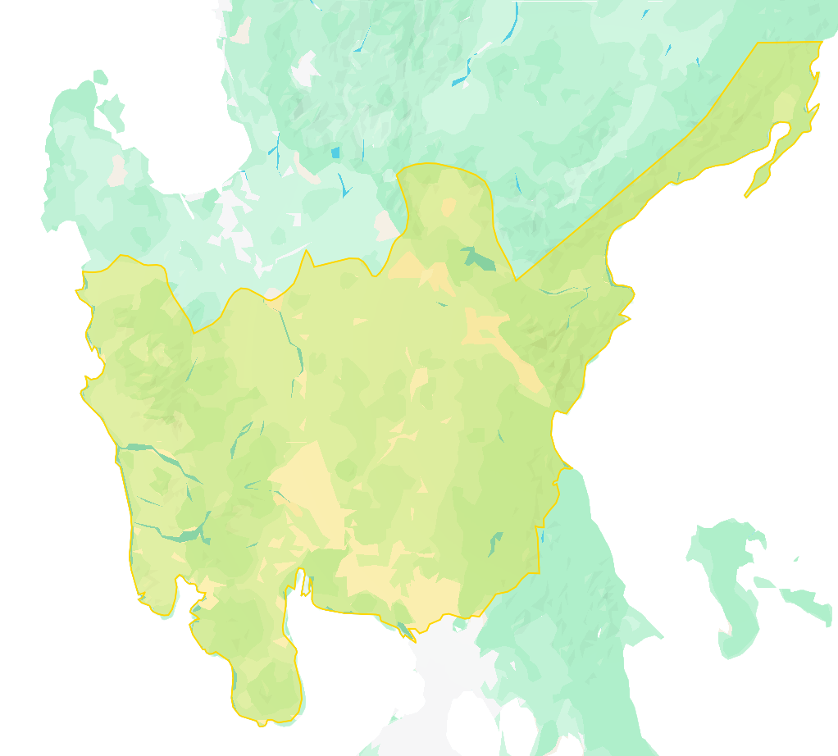
III- Central Luzon
Underlying Issues:
Informal settlements, migration, unstable jobs
Recommendations:
“FDS Anywhere” Mobile Program and Barangay Pop-Ups
FDS Participation Policy with employers
Health and
Nutrition
Child Labor
Education
Community Participation
44

Slide 45
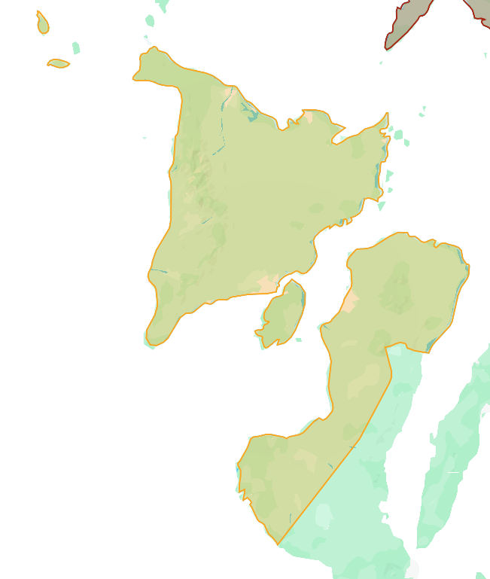
VI - Western Visayas
Underlying Issues:
Rural poverty
Recommendations:
Farm-to Classroom Income Diversion Program
Seasonal Youth Support Scholarships
Health and
Nutrition
Child Labor
Education
Community Participation
45

Slide 46
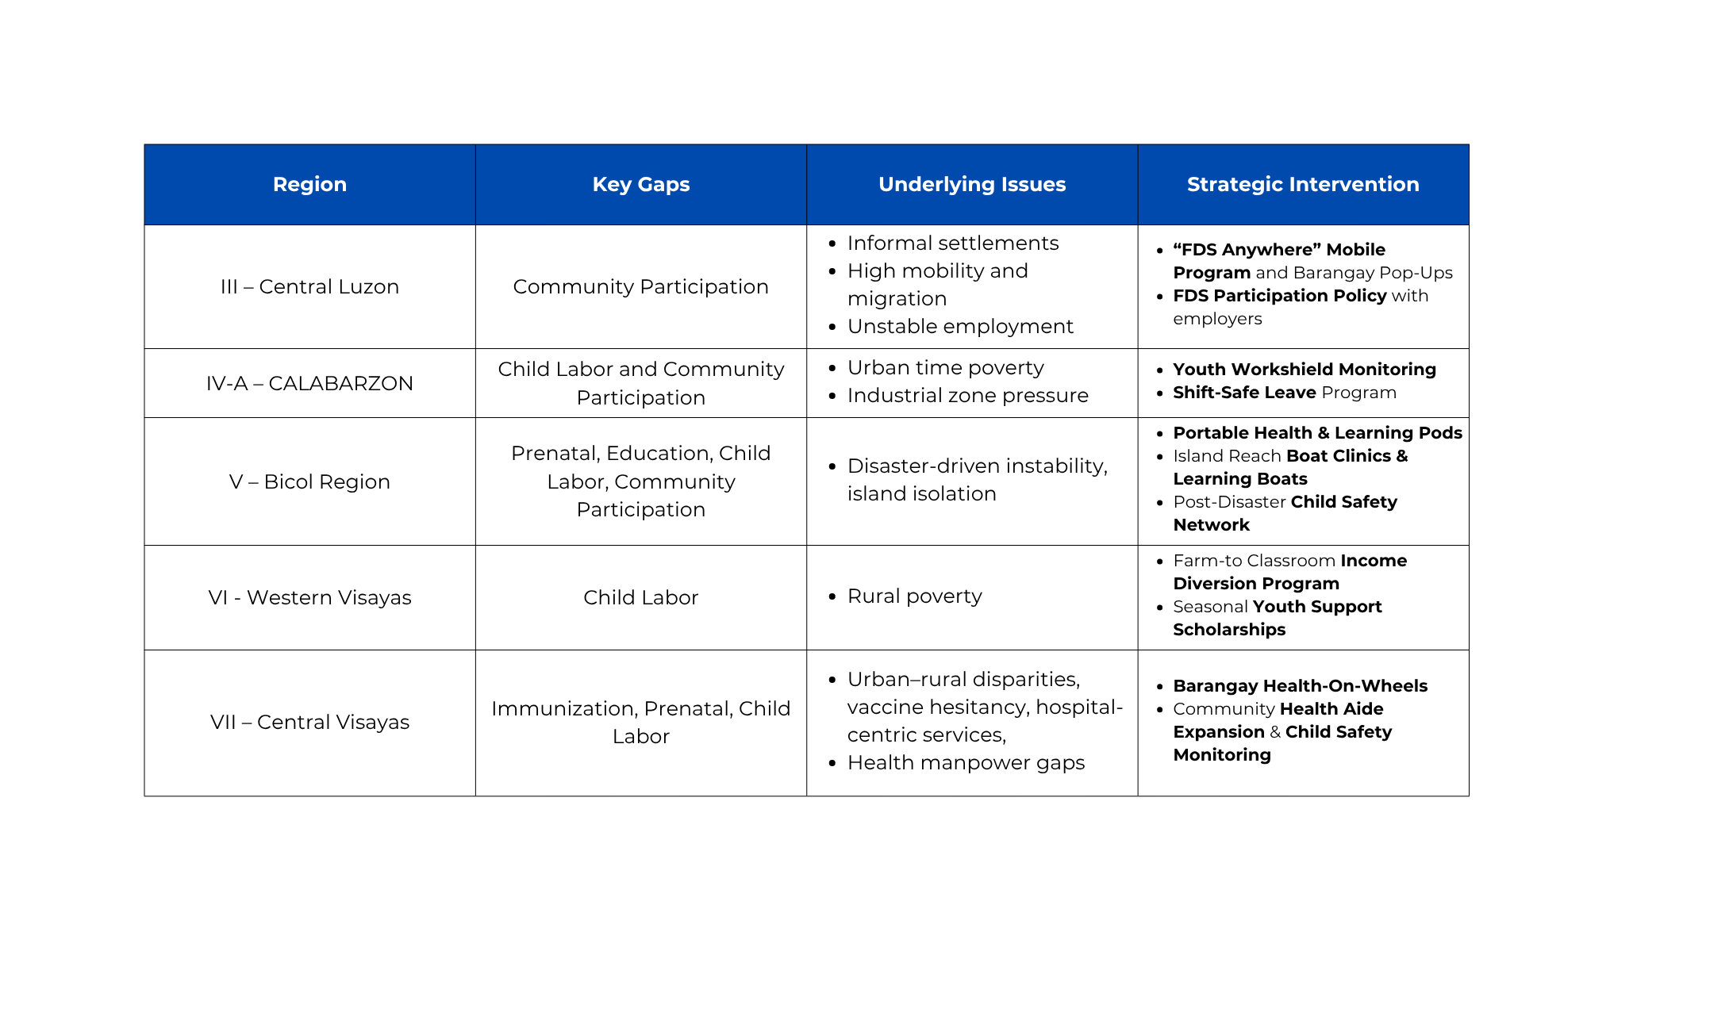
46

Slide 47

47

Slide 48
Investing in these interventions means investing in empowered families, stronger communities, and a more effective program.
48

Slide 49

4TW

Slide 50
References:
Poverty & Regional Statistics
Onsay, R. V., Panganiban, V. G., & de la Cruz, M. M. S. (2024). Measuring the unmeasurable multidimensional poverty [Academic paper]. [Check Google Scholar or university libraries].
Philippine Statistics Authority. (2024). Regional poverty data 2024. Retrieved November 15, 2025, from SECTION A: WHY REGIONS UNDERPERFORM (Root Causes)
POVERTY & REGIONAL STATISTICS
Philippine Statistics Authority (PSA) - Regional Poverty Data 2024Key Finding: BARMM 23.5%, Zamboanga 24.4%, Bicol 20.3% poverty rates
Link: https://psa.gov.ph/statistics/poverty (search for "poverty statistics Philippines 2024")
Relevance: Explains baseline poverty context for underperforming regions
Onsay et al. (2024) - "Measuring the unmeasurable multidimensional poverty"Key Finding: Camarines Sur (Bicol) at 38.7% poverty incidence (2021)
Link: Academic paper (check Google Scholar or university libraries)
Relevance: Documents disaster vulnerability compounding poverty in Bicol
World Bank Philippines Urbanization Review (2017)Key Finding: 5.4% urban population (2.2M) in informal settlements; "trapped in informal sector out of necessity"
Link: https://www.worldbank.org/en/country/philippines
Relevance: Explains time poverty in urbanized Central Luzon/CALABARZON
World Bank. (2017). Philippines urbanization review. Retrieved November 15, 2025, from SECTION A: WHY REGIONS UNDERPERFORM (Root Causes)
POVERTY & REGIONAL STATISTICS
Philippine Statistics Authority (PSA) - Regional Poverty Data 2024Key Finding: BARMM 23.5%, Zamboanga 24.4%, Bicol 20.3% poverty rates
Link: https://psa.gov.ph/statistics/poverty (search for "poverty statistics Philippines 2024")
Relevance: Explains baseline poverty context for underperforming regions
Onsay et al. (2024) - "Measuring the unmeasurable multidimensional poverty"Key Finding: Camarines Sur (Bicol) at 38.7% poverty incidence (2021)
Link: Academic paper (check Google Scholar or university libraries)
Relevance: Documents disaster vulnerability compounding poverty in Bicol
World Bank Philippines Urbanization Review (2017)Key Finding: 5.4% urban population (2.2M) in informal settlements; "trapped in informal sector out of necessity"
Link: https://www.worldbank.org/en/country/philippines
Relevance: Explains time poverty in urbanized Central Luzon/CALABARZON
Geographic Isolation & Terrain
DepEd Caraga Regional Profile. (2025). DepEd Caraga. Retrieved November 15, 2025, from SECTION A: WHY REGIONS UNDERPERFORM (Root Causes)
POVERTY & REGIONAL STATISTICS
Philippine Statistics Authority (PSA) - Regional Poverty Data 2024Key Finding: BARMM 23.5%, Zamboanga 24.4%, Bicol 20.3% poverty rates
Link: https://psa.gov.ph/statistics/poverty (search for "poverty statistics Philippines 2024")
Relevance: Explains baseline poverty context for underperforming regions
Onsay et al. (2024) - "Measuring the unmeasurable multidimensional poverty"Key Finding: Camarines Sur (Bicol) at 38.7% poverty incidence (2021)
Link: Academic paper (check Google Scholar or university libraries)
Relevance: Documents disaster vulnerability compounding poverty in Bicol
World Bank Philippines Urbanization Review (2017)Key Finding: 5.4% urban population (2.2M) in informal settlements; "trapped in informal sector out of necessity"
Link: https://www.worldbank.org/en/country/philippines
Relevance: Explains time poverty in urbanized Central Luzon/CALABARZON (look for regional profile/reports section)
Philippine Statistics Authority. (2020). Proportion of urban population: 2020 Census of Population and Housing. Retrieved November 15, 2025, from SECTION A: WHY REGIONS UNDERPERFORM (Root Causes)
POVERTY & REGIONAL STATISTICS
Philippine Statistics Authority (PSA) - Regional Poverty Data 2024Key Finding: BARMM 23.5%, Zamboanga 24.4%, Bicol 20.3% poverty rates
Link: https://psa.gov.ph/statistics/poverty (search for "poverty statistics Philippines 2024")
Relevance: Explains baseline poverty context for underperforming regions
Onsay et al. (2024) - "Measuring the unmeasurable multidimensional poverty"Key Finding: Camarines Sur (Bicol) at 38.7% poverty incidence (2021)
Link: Academic paper (check Google Scholar or university libraries)
Relevance: Documents disaster vulnerability compounding poverty in Bicol
World Bank Philippines Urbanization Review (2017)Key Finding: 5.4% urban population (2.2M) in informal settlements; "trapped in informal sector out of necessity"
Link: https://www.worldbank.org/en/country/philippines
Relevance: Explains time poverty in urbanized Central Luzon/CALABARZON
Philippine Statistics Authority. (2020–2024). Central Luzon & CALABARZON census data. Retrieved November 15, 2025, from SECTION A: WHY REGIONS UNDERPERFORM (Root Causes)
POVERTY & REGIONAL STATISTICS
Philippine Statistics Authority (PSA) - Regional Poverty Data 2024Key Finding: BARMM 23.5%, Zamboanga 24.4%, Bicol 20.3% poverty rates
Link: https://psa.gov.ph/statistics/poverty (search for "poverty statistics Philippines 2024")
Relevance: Explains baseline poverty context for underperforming regions
Onsay et al. (2024) - "Measuring the unmeasurable multidimensional poverty"Key Finding: Camarines Sur (Bicol) at 38.7% poverty incidence (2021)
Link: Academic paper (check Google Scholar or university libraries)
Relevance: Documents disaster vulnerability compounding poverty in Bicol
World Bank Philippines Urbanization Review (2017)Key Finding: 5.4% urban population (2.2M) in informal settlements; "trapped in informal sector out of necessity"
Link: https://www.worldbank.org/en/country/philippines
Relevance: Explains time poverty in urbanized Central Luzon/CALABARZON
Disaster Vulnerability
Alcayna, T., Gupit, G., & Faraon, J. (2016). Resilience and disaster trends in the Philippines: Opportunities for national and local capacity building. PLOS Currents: Disasters. SECTION A: WHY REGIONS UNDERPERFORM (Root Causes)
POVERTY & REGIONAL STATISTICS
Philippine Statistics Authority (PSA) - Regional Poverty Data 2024Key Finding: BARMM 23.5%, Zamboanga 24.4%, Bicol 20.3% poverty rates
Link: https://psa.gov.ph/statistics/poverty (search for "poverty statistics Philippines 2024")
Relevance: Explains baseline poverty context for underperforming regions
Onsay et al. (2024) - "Measuring the unmeasurable multidimensional poverty"Key Finding: Camarines Sur (Bicol) at 38.7% poverty incidence (2021)
Link: Academic paper (check Google Scholar or university libraries)
Relevance: Documents disaster vulnerability compounding poverty in Bicol
World Bank Philippines Urbanization Review (2017)Key Finding: 5.4% urban population (2.2M) in informal settlements; "trapped in informal sector out of necessity"
Link: https://www.worldbank.org/en/country/philippines
Relevance: Explains time poverty in urbanized Central Luzon/CALABARZON
Evolving Disaster Resilience in Philippines. (2025). ScienceDirect. SECTION A: WHY REGIONS UNDERPERFORM (Root Causes)
POVERTY & REGIONAL STATISTICS
Philippine Statistics Authority (PSA) - Regional Poverty Data 2024Key Finding: BARMM 23.5%, Zamboanga 24.4%, Bicol 20.3% poverty rates
Link: https://psa.gov.ph/statistics/poverty (search for "poverty statistics Philippines 2024")
Relevance: Explains baseline poverty context for underperforming regions
Onsay et al. (2024) - "Measuring the unmeasurable multidimensional poverty"Key Finding: Camarines Sur (Bicol) at 38.7% poverty incidence (2021)
Link: Academic paper (check Google Scholar or university libraries)
Relevance: Documents disaster vulnerability compounding poverty in Bicol
World Bank Philippines Urbanization Review (2017)Key Finding: 5.4% urban population (2.2M) in informal settlements; "trapped in informal sector out of necessity"
Link: https://www.worldbank.org/en/country/philippines
Relevance: Explains time poverty in urbanized Central Luzon/CALABARZON
Geographical Magazine. (2024). Why Philippines experiences so many typhoons. [Search "Philippines typhoon belt Bicol Eastern Visayas 2024"].
World Risk Report & Disaster Statistics. (n.d.). World Risk Report. Retrieved November 15, 2025, from SECTION A: WHY REGIONS UNDERPERFORM (Root Causes)
POVERTY & REGIONAL STATISTICS
Philippine Statistics Authority (PSA) - Regional Poverty Data 2024Key Finding: BARMM 23.5%, Zamboanga 24.4%, Bicol 20.3% poverty rates
Link: https://psa.gov.ph/statistics/poverty (search for "poverty statistics Philippines 2024")
Relevance: Explains baseline poverty context for underperforming regions
Onsay et al. (2024) - "Measuring the unmeasurable multidimensional poverty"Key Finding: Camarines Sur (Bicol) at 38.7% poverty incidence (2021)
Link: Academic paper (check Google Scholar or university libraries)
Relevance: Documents disaster vulnerability compounding poverty in Bicol
World Bank Philippines Urbanization Review (2017)Key Finding: 5.4% urban population (2.2M) in informal settlements; "trapped in informal sector out of necessity"
Link: https://www.worldbank.org/en/country/philippines
Relevance: Explains time poverty in urbanized Central Luzon/CALABARZON or UNDRR disaster statistics.
50

Slide 51
References:
POVERTY & REGIONAL STATISTICS
Philippine Statistics Authority (PSA) - Regional Poverty Data 2024Key Finding: BARMM 23.5%, Zamboanga 24.4%, Bicol 20.3% poverty rates
Link: https://psa.gov.ph/statistics/poverty (search for "poverty statistics Philippines 2024")
Relevance: Explains baseline poverty context for underperforming regions
Onsay et al. (2024) - "Measuring the unmeasurable multidimensional poverty"Key Finding: Camarines Sur (Bicol) at 38.7% poverty incidence (2021)
Link: Academic paper (check Google Scholar or university libraries)
Relevance: Documents disaster vulnerability compounding poverty in Bicol
World Bank Philippines Urbanization Review (2017)Key Finding: 5.4% urban population (2.2M) in informal settlements; "trapped in informal sector out of necessity"
Link: https://www.worldbank.org/en/country/philippines
Relevance: Explains time poverty in urbanized Central Luzon/CALABARZON
Geographic Isolation & Terrain
DepEd Caraga Regional Profile. (2025). DepEd Caraga. Retrieved November 15, 2025, from SECTION A: WHY REGIONS UNDERPERFORM (Root Causes)
POVERTY & REGIONAL STATISTICS
Philippine Statistics Authority (PSA) - Regional Poverty Data 2024Key Finding: BARMM 23.5%, Zamboanga 24.4%, Bicol 20.3% poverty rates
Link: https://psa.gov.ph/statistics/poverty (search for "poverty statistics Philippines 2024")
Relevance: Explains baseline poverty context for underperforming regions
Onsay et al. (2024) - "Measuring the unmeasurable multidimensional poverty"Key Finding: Camarines Sur (Bicol) at 38.7% poverty incidence (2021)
Link: Academic paper (check Google Scholar or university libraries)
Relevance: Documents disaster vulnerability compounding poverty in Bicol
World Bank Philippines Urbanization Review (2017)Key Finding: 5.4% urban population (2.2M) in informal settlements; "trapped in informal sector out of necessity"
Link: https://www.worldbank.org/en/country/philippines
Relevance: Explains time poverty in urbanized Central Luzon/CALABARZON (look for regional profile/reports section)
Philippine Statistics Authority. (2020). Proportion of urban population: 2020 Census of Population and Housing. Retrieved November 15, 2025, from SECTION A: WHY REGIONS UNDERPERFORM (Root Causes)
POVERTY & REGIONAL STATISTICS
Philippine Statistics Authority (PSA) - Regional Poverty Data 2024Key Finding: BARMM 23.5%, Zamboanga 24.4%, Bicol 20.3% poverty rates
Link: https://psa.gov.ph/statistics/poverty (search for "poverty statistics Philippines 2024")
Relevance: Explains baseline poverty context for underperforming regions
Onsay et al. (2024) - "Measuring the unmeasurable multidimensional poverty"Key Finding: Camarines Sur (Bicol) at 38.7% poverty incidence (2021)
Link: Academic paper (check Google Scholar or university libraries)
Relevance: Documents disaster vulnerability compounding poverty in Bicol
World Bank Philippines Urbanization Review (2017)Key Finding: 5.4% urban population (2.2M) in informal settlements; "trapped in informal sector out of necessity"
Link: https://www.worldbank.org/en/country/philippines
Relevance: Explains time poverty in urbanized Central Luzon/CALABARZON
Philippine Statistics Authority. (2020–2024). Central Luzon & CALABARZON census data. Retrieved November 15, 2025, from SECTION A: WHY REGIONS UNDERPERFORM (Root Causes)
POVERTY & REGIONAL STATISTICS
Philippine Statistics Authority (PSA) - Regional Poverty Data 2024Key Finding: BARMM 23.5%, Zamboanga 24.4%, Bicol 20.3% poverty rates
Link: https://psa.gov.ph/statistics/poverty (search for "poverty statistics Philippines 2024")
Relevance: Explains baseline poverty context for underperforming regions
Onsay et al. (2024) - "Measuring the unmeasurable multidimensional poverty"Key Finding: Camarines Sur (Bicol) at 38.7% poverty incidence (2021)
Link: Academic paper (check Google Scholar or university libraries)
Relevance: Documents disaster vulnerability compounding poverty in Bicol
World Bank Philippines Urbanization Review (2017)Key Finding: 5.4% urban population (2.2M) in informal settlements; "trapped in informal sector out of necessity"
Link: https://www.worldbank.org/en/country/philippines
Relevance: Explains time poverty in urbanized Central Luzon/CALABARZON
Disaster Vulnerability
Alcayna, T., Gupit, G., & Faraon, J. (2016). Resilience and disaster trends in the Philippines: Opportunities for national and local capacity building. PLOS Currents: Disasters. SECTION A: WHY REGIONS UNDERPERFORM (Root Causes)
POVERTY & REGIONAL STATISTICS
Philippine Statistics Authority (PSA) - Regional Poverty Data 2024Key Finding: BARMM 23.5%, Zamboanga 24.4%, Bicol 20.3% poverty rates
Link: https://psa.gov.ph/statistics/poverty (search for "poverty statistics Philippines 2024")
Relevance: Explains baseline poverty context for underperforming regions
Onsay et al. (2024) - "Measuring the unmeasurable multidimensional poverty"Key Finding: Camarines Sur (Bicol) at 38.7% poverty incidence (2021)
Link: Academic paper (check Google Scholar or university libraries)
Relevance: Documents disaster vulnerability compounding poverty in Bicol
World Bank Philippines Urbanization Review (2017)Key Finding: 5.4% urban population (2.2M) in informal settlements; "trapped in informal sector out of necessity"
Link: https://www.worldbank.org/en/country/philippines
Relevance: Explains time poverty in urbanized Central Luzon/CALABARZON
Evolving Disaster Resilience in Philippines. (2025). ScienceDirect. SECTION A: WHY REGIONS UNDERPERFORM (Root Causes)
POVERTY & REGIONAL STATISTICS
Philippine Statistics Authority (PSA) - Regional Poverty Data 2024Key Finding: BARMM 23.5%, Zamboanga 24.4%, Bicol 20.3% poverty rates
Link: https://psa.gov.ph/statistics/poverty (search for "poverty statistics Philippines 2024")
Relevance: Explains baseline poverty context for underperforming regions
Onsay et al. (2024) - "Measuring the unmeasurable multidimensional poverty"Key Finding: Camarines Sur (Bicol) at 38.7% poverty incidence (2021)
Link: Academic paper (check Google Scholar or university libraries)
Relevance: Documents disaster vulnerability compounding poverty in Bicol
World Bank Philippines Urbanization Review (2017)Key Finding: 5.4% urban population (2.2M) in informal settlements; "trapped in informal sector out of necessity"
Link: https://www.worldbank.org/en/country/philippines
Relevance: Explains time poverty in urbanized Central Luzon/CALABARZON
Geographical Magazine. (2024). Why Philippines experiences so many typhoons. [Search "Philippines typhoon belt Bicol Eastern Visayas 2024"].
World Risk Report & Disaster Statistics. (n.d.). World Risk Report. Retrieved November 15, 2025, from SECTION A: WHY REGIONS UNDERPERFORM (Root Causes)
POVERTY & REGIONAL STATISTICS
Philippine Statistics Authority (PSA) - Regional Poverty Data 2024Key Finding: BARMM 23.5%, Zamboanga 24.4%, Bicol 20.3% poverty rates
Link: https://psa.gov.ph/statistics/poverty (search for "poverty statistics Philippines 2024")
Relevance: Explains baseline poverty context for underperforming regions
Onsay et al. (2024) - "Measuring the unmeasurable multidimensional poverty"Key Finding: Camarines Sur (Bicol) at 38.7% poverty incidence (2021)
Link: Academic paper (check Google Scholar or university libraries)
Relevance: Documents disaster vulnerability compounding poverty in Bicol
World Bank Philippines Urbanization Review (2017)Key Finding: 5.4% urban population (2.2M) in informal settlements; "trapped in informal sector out of necessity"
Link: https://www.worldbank.org/en/country/philippines
Relevance: Explains time poverty in urbanized Central Luzon/CALABARZON or UNDRR disaster statistics.
51

Slide 52
References:
Philippine Statistics Authority (PSA) - Regional Poverty Data 2024Key Finding: BARMM 23.5%, Zamboanga 24.4%, Bicol 20.3% poverty rates
Link: https://psa.gov.ph/statistics/poverty (search for "poverty statistics Philippines 2024")
Relevance: Explains baseline poverty context for underperforming regions
Onsay et al. (2024) - "Measuring the unmeasurable multidimensional poverty"Key Finding: Camarines Sur (Bicol) at 38.7% poverty incidence (2021)
Link: Academic paper (check Google Scholar or university libraries)
Relevance: Documents disaster vulnerability compounding poverty in Bicol
World Bank Philippines Urbanization Review (2017)Key Finding: 5.4% urban population (2.2M) in informal settlements; "trapped in informal sector out of necessity"
Link: https://www.worldbank.org/en/country/philippines
Relevance: Explains time poverty in urbanized Central Luzon/CALABARZON (look for regional profile/reports section)
Philippine Statistics Authority. (2020). Proportion of urban population: 2020 Census of Population and Housing. Retrieved November 15, 2025, from SECTION A: WHY REGIONS UNDERPERFORM (Root Causes)
POVERTY & REGIONAL STATISTICS
Philippine Statistics Authority (PSA) - Regional Poverty Data 2024Key Finding: BARMM 23.5%, Zamboanga 24.4%, Bicol 20.3% poverty rates
52

